Slide 1

UNIVERSITY INSTITUTE OF ENGINEERING
COMPUTER SCIENCE ENGINEERING
Computer Vision (CST-422)
Prepared By : Payal Thakur(E12720)
Topic: Detecting Objects with Segmentation, Motion Detection: Detecting Motion, Stabilizing Video with Template Matching
DISCOVER . LEARN . EMPOWER

Slide 2
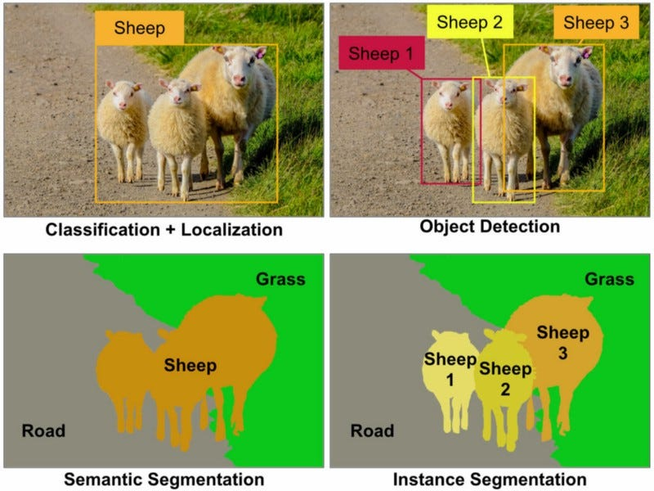
Introduction to Object Detection with Segmentation

Slide 3
Definition of object detection and its importance in computer vision
Object detection refers to the task of identifying and localizing objects within images or video frames.
It plays a crucial role in various applications such as autonomous driving, video surveillance, and image understanding.

Slide 4
Introduction to segmentation as a technique for object detection
Segmentation involves partitioning an image into meaningful regions based on visual characteristics.
It helps to differentiate objects from the background and allows for precise object localization.

Slide 5
Key challenges in object detection with segmentation
Accurately distinguishing between multiple objects with complex shapes, sizes, and occlusions.
Handling variations in lighting conditions, viewpoint, and scale.
Dealing with real-time processing requirements for applications like video surveillance.

Slide 6
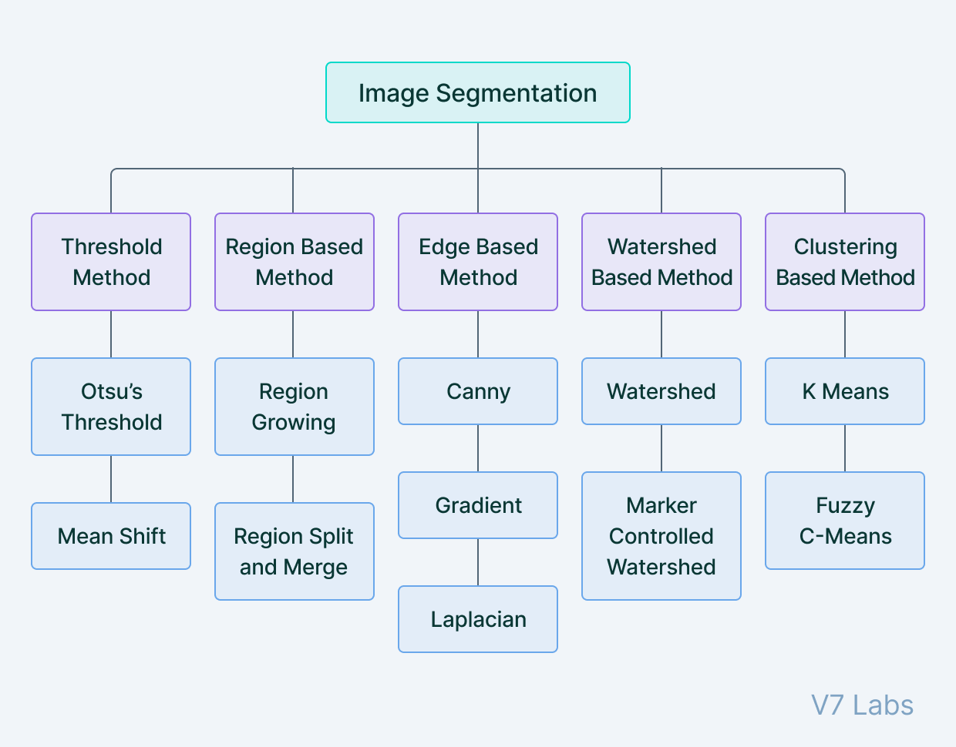
Image Segmentation

Slide 7
Popular Segmentation Algorithms
Thresholding-based segmentation:
1. Basic thresholding techniques:
- Simple thresholding methods use a fixed threshold value to separate objects from the background based on pixel intensity.
- Techniques like global thresholding, binary thresholding, and adaptive thresholding are commonly used.
2. Adaptive thresholding:
- Adaptive thresholding adjusts the threshold value locally based on the image characteristics, leading to improved segmentation results.

Slide 8
Popular Segmentation Algorithms
B. Region-based segmentation:
1. Connected component analysis:
- This technique groups pixels into connected components based on pixel similarity or connectivity.
- It helps identify separate objects or regions within an image.
2. Region growing algorithms:
- Region growing starts with seed points and iteratively expands regions based on similarity criteria.
- It allows for the segmentation of objects with varying texture, color, or intensity.

Slide 9
Popular Segmentation Algorithms
C. Edge-based segmentation:
1. Canny edge detection:
- Canny edge detection algorithm identifies edges by detecting significant changes in pixel intensity.
- It provides edge maps that can be further processed to segment objects.
2. Hough transform for object detection:
- The Hough transform is used to detect geometric shapes, such as lines or circles, which can aid in object detection.

Slide 10
Introduction to advanced segmentation algorithms
1. Watershed algorithm:
- The watershed algorithm treats an image as a topographic landscape and separates regions based on the flooding process.
- It can handle complex object boundaries and is suitable for applications like cell segmentation.
2. Graph-cut-based segmentation:
- Graph-cut algorithms model image segmentation as an energy minimization problem and achieve accurate results.
- They can handle challenging cases with object occlusions or irregular shapes.
3. GrabCut algorithm:
- The GrabCut algorithm combines interactive user inputs with an iterative graph-cut-based optimization to segment objects from the background.

Slide 11
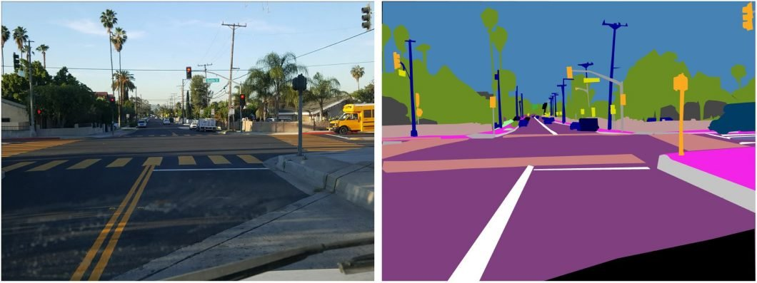
Deep Learning-Based Segmentation

Slide 12
Overview of deep learning for segmentation
Deep learning techniques, particularly convolutional neural networks (CNNs), have shown significant advancements in object detection and segmentation.
Fully Convolutional Networks (FCNs):
- FCNs are CNN architectures designed for end-to-end pixel-level segmentation.
- They replace fully connected layers with convolutional layers to preserve spatial information.
U-Net architecture for segmentation:
- The U-Net architecture is a popular choice for biomedical image segmentation tasks.
- It consists of an encoder-decoder network with skip connections to capture both local and global information.

Slide 13
Overview of deep learning for segmentation
Mask R-CNN for object detection and segmentation:
- Mask R-CNN is a state-of-the-art framework that combines object detection with pixel-level segmentation.
- It extends Faster R-CNN by adding a segmentation branch to generate object masks alongside bounding box predictions.

Slide 14
Evaluation and Metrics for Object Detection with Segmentation
A. Intersection over Union (IoU) metric:
- IoU measures the overlap between the predicted segmentation mask and the ground truth mask.
- It is calculated as the ratio of the intersection area to the union area.
B. Average Precision (AP) and mean Average Precision (mAP):
- AP evaluates the precision and recall of object detection algorithms at different IoU thresholds.
- mAP averages the AP values across multiple object classes and is commonly used to assess segmentation performance.
C. Precision-Recall curve and F1-score:
- Precision-Recall curves visualize the trade-off between precision and recall for different segmentation thresholds.
- F1-score provides a single measure that balances precision and recall.

Slide 15
Applications and Use Cases
A. Semantic segmentation for scene understanding:
- Semantic segmentation assigns a semantic label to each pixel in an image, enabling detailed scene analysis.
- It finds applications in autonomous driving, image editing, and augmented reality.
B. Instance segmentation for object localization and tracking:
- Instance segmentation identifies and distinguishes individual objects within a scene.
- It is crucial for applications like robotics, video surveillance, and human-computer interaction.
C. Medical imaging applications of segmentation:
- Segmentation plays a vital role in medical image analysis, such as tumor detection, organ segmentation, and lesion identification.
D. Autonomous driving and surveillance applications:
- Object detection with segmentation is crucial for autonomous vehicles to detect and localize pedestrians, vehicles, and other objects.
- In surveillance, it helps in identifying and tracking suspicious activities or objects of interest.

Slide 16
Motion Detection
A. Importance of motion detection in computer vision applications:
- Motion detection is essential for various computer vision tasks, including video surveillance, activity recognition, object tracking, and human-computer interaction.
B. Difference between motion detection and object tracking:
- Motion detection focuses on identifying regions in an image or video that exhibit significant changes over time.
- Object tracking involves following a specific object or multiple objects across consecutive frames.
C. Applications of motion detection in video surveillance, robotics, and human-computer interaction:
- Motion detection is widely used in security systems to detect intrusions or suspicious activities.
- In robotics, motion detection helps in obstacle detection and avoidance.
- It also plays a role in gesture recognition and interactive applications.

